Slide 1
Taste Test Azure’s AI Services!
with Cassie Breviu

Slide 2


Cassie Breviu
Cloud Advocate at Microsoft
@Cassieview

Slide 3





Agenda
What Azure Cloud is and Cloud Architecture Options
What is AI?
What AI Services does Azure offer? (Hint: LOTS)
Learn about Microsoft Learn
How to use the AI Services

Slide 4
Notes:
So let's get right to the big question – What is Azure?
Azure is Microsoft's cloud computing platform. If you were to look on our website, it says…

Slide 5
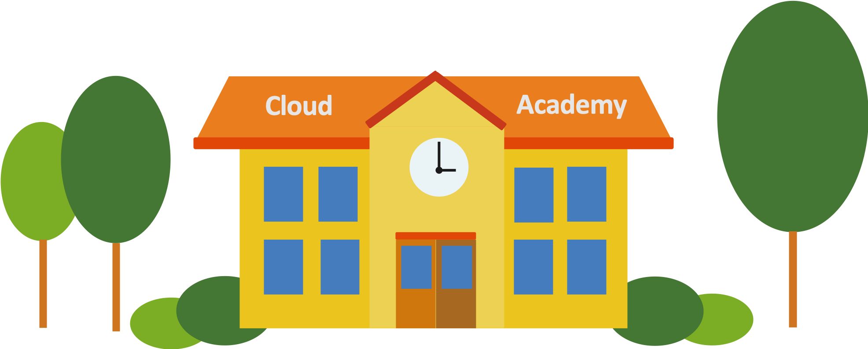
“Microsoft Azure is an ever-expanding set of cloud services to help your organization meet your business challenges. It’s the freedom to build, manage, and deploy applications on a massive, global network using your favorite tools and frameworks.”
Notes:
Sounds great!
What exactly does this mean though?
What is the cloud? Is it one thing? Where can I buy one? How much does 1 cloud cost?

Slide 6

Notes:
In order to understand Azure, we have to first understand the fundamentals of cloud computing.
The 101 of “The Cloud” if you will here at Cloud Academy
And your first lesson, is the client server model and what a data center is!

Slide 7




Client-Server Model
Server
Laptop Client
Desktop Client
Mobile Client
Notes:
This is the client server model some of you may be familiar with this but just to make sure everyone is – lets review it quick.
You build a cool website and you have it running locally on your computer but you want to host it so anyone can access it from a browser. You need to put your code on a server to accomplish this. A server is a just a computer with a different OS (operating system).
So you put your code on a server to host your site and send the link to your friend. Your friend clicks the link from a mobile client.
A client makes a request to your server and your server returns your awesome site to your friends phone.

Slide 8
Client-Server Model
Data Center
Laptop Client
Desktop Client
Mobile Client
Notes:
Now your friend shares your awesome site on twitter and it goes viral. That one server is no longer enough to support the traffic. You need to add more computers/servers or scale to support all the traffic. When you start adding more servers and they need their own room. This is basically a data center.

Slide 9


Client-Server Model
Azure Cloud
Laptop Client
Desktop Client
Mobile Client
Notes:
And at a basic level azure is your data center/server room but its that and so much more!

Slide 10







What is cloud computing?
=
Notes:
Another way to say it simply is the cloud is a bunch of computers connected thru the internet that you can run programs on – both your own or prebuilt services.

Slide 11
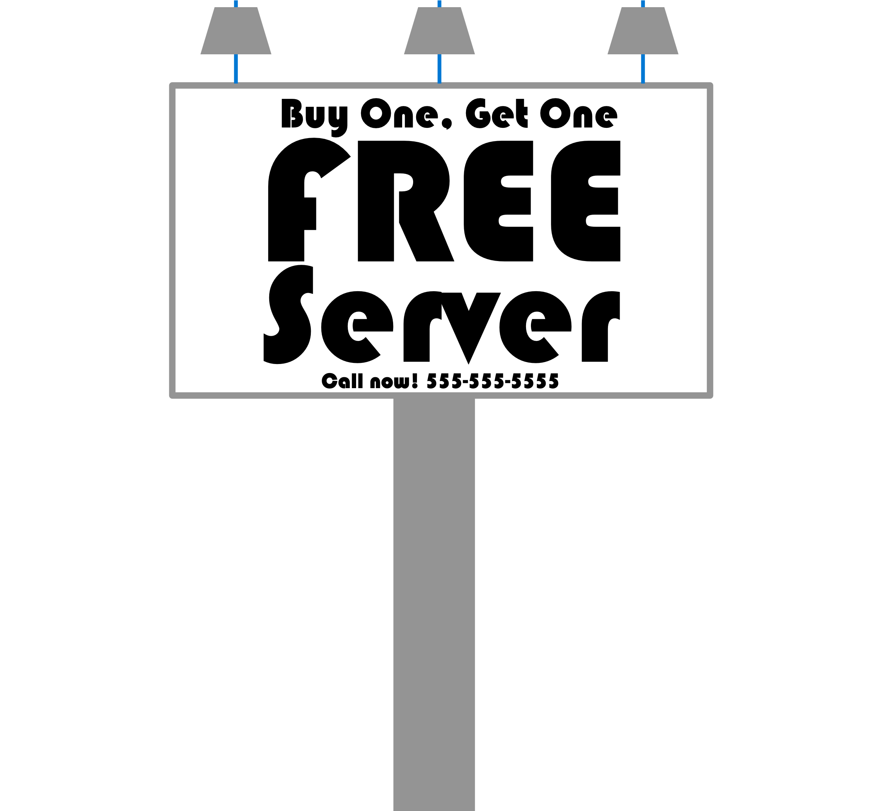
Cloud
On Premise
On-Prem
Academy
Notes:
Time for a bit of history lesson.
In the beginning, we all had data centers
Software you own, running on servers you own, sitting in a room down the hall from your desk
We call this “on premise”. You’ll often hear it abbreviated as “On Prem”.

Slide 12
Cloud
Academy
Infrastructure as a Service
IaaS
C#
Notes:
When the cloud first came on to the scene in around 2007, it was mostly about renting servers from someone else
This is where you rent a server from Microsoft.
Microsoft hosts the server for you in some data center somewhere
This was primarily powered by the concept of virtual machines.
Virtual machines are not physical servers, so they can be configured remotely
But IaaS didn’t really change anything for developers, because, we don’t really care about this.

Slide 13
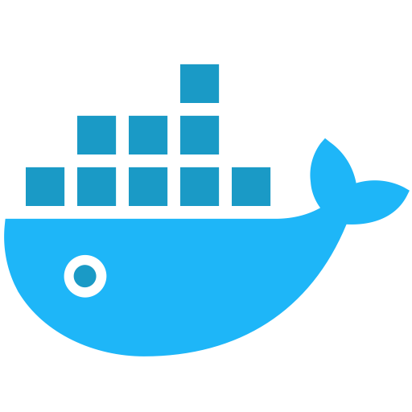
Cloud
Platform as a Service
Academy
PaaS
C#
Notes:
Then PaaS came along
Platform as a Service
This is an abstraction on top of the virtual machine.
You just upload your code or let the provider grab it from a Github repo
You can scale up or down as needed and add compute resources as needed.

Slide 14
Cloud
C#
Containers
docker
Academy
static void main()
Notes:
Then came containers. This would be things like Docker. If you’re not familiar with Docker and containers, that’s ok. You’re fine. Just know that a Docker container is kind of like a .exe. You take your program, along with all it’s dependencies, and you put it inside of this thing called a ”Container”. That container is like an .exe that you can deploy to a server and it just works. This makes deploying applications simple because you know that if it runs on your machine, it will run on the server as well.

Slide 15
Cloud
Serverless
Academy
static void main()
Notes:
The newest concept in cloud computing is Serverless. This is where you don’t worry about the runtime or even the framework in which your code runs. In other words, you could throw the contents of a single .cs file up onto a server and it will run just fine. You don’t need a project file or any of the code infrastructure that we typically think about when we write code. These platforms are perfect for things like micro-services and API’s.

Slide 16

Cloud
static void main()
iaas
paas
Containers
Academy
serverless
Notes:
So that is cloud computing architecture options in a nutshell. IaaS, PaaS, Containers and Serverless.

Slide 17
Cloud
iaas
sass
paas
Containers
serverless
Academy
?
Notes:
There is also another thing that sort of happened in parallel to all of this and that’s Software as a Service.
Single services running in the cloud that we consume.
Github, Salesforce, Email.
We figured out already that consuming services is superior to trying to install and manage them yourself.
Most of us are already using some sort of SaaS where we work. How many people here are using Office 365? Github? Dropbox? Any others that your company is using?
These things are also all in “the cloud” to an extent.

Slide 18
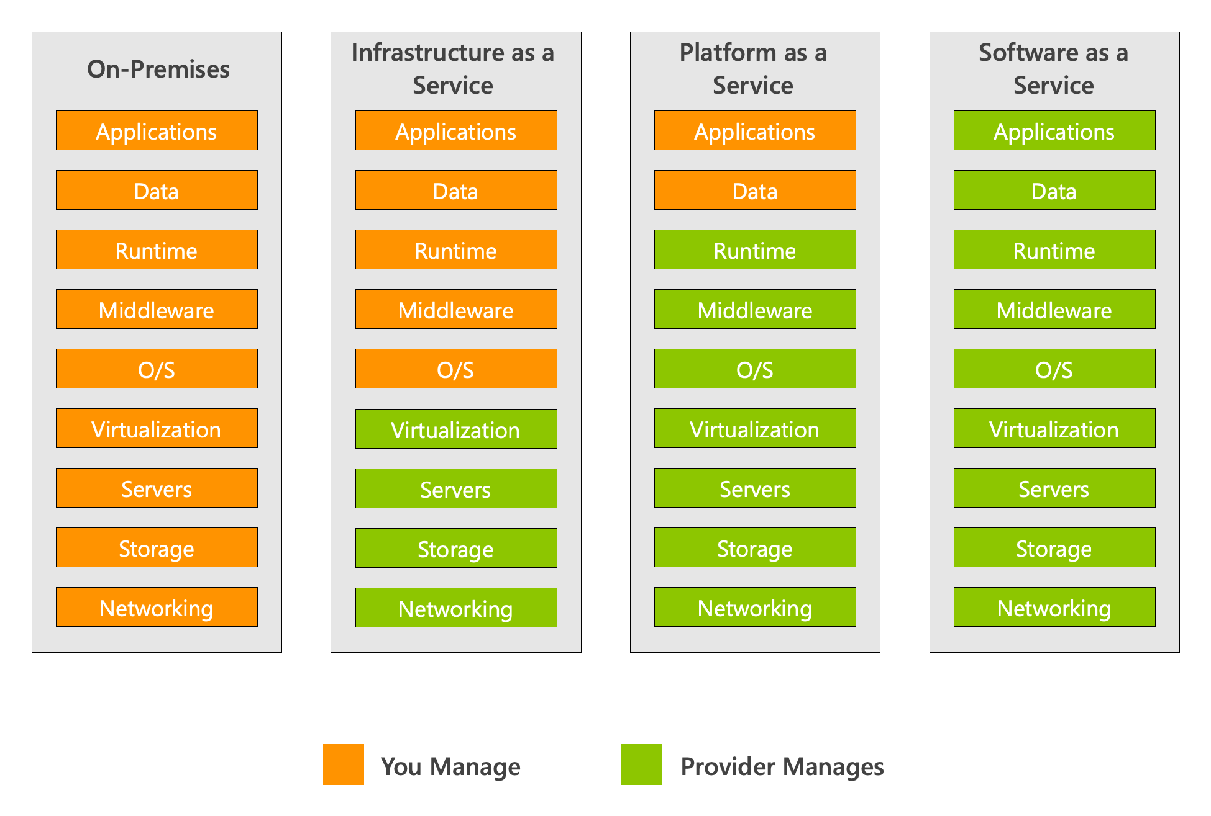
Notes:
This can all be a tad confusing as to what constitutes what kind of cloud and what sort of cloud category.
This slide does a good job of helping you visualize how what you manage decreases as you move from an on-premise solution to a full SaaS solution.
With on-prem, you own it all.
With IaaS, everything from the OS level up is managed by you.
With PaaS, the data and the application level are managed by you.
And with SaaS, everything is managed by the provider.

Slide 19
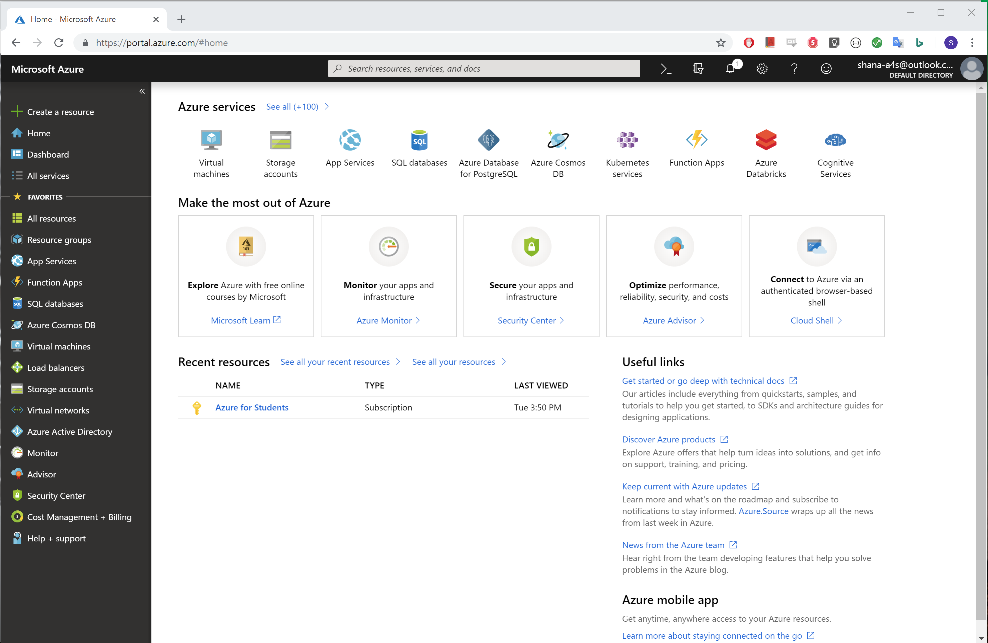
How do you access this magical technology?
Notes:
How do access this?
Azure.portal.com and you create resources with a web interface on the browser of your choice
Which we all know is edge right?! Cause its chromium based now! WOOT

Slide 20


What is AI?

Slide 21
What is AI, ML and DL?
Artificial intelligence (AI) is a technique that enables computers to mimic human intelligence. It includes machine learning.
Machine learning (ML) is a subset of artificial intelligence that includes techniques (such as deep learning) that enable machines to improve at tasks with experience.
Deep learning (DL) is a subset of machine learning based on artificial neural networks that permit a machine to train itself.
aka.ms/HackMIT/
Notes:
In order to understand the difference between deep learning vs. machine learning vs. AI, learn about each of these fields of study:
Artificial intelligence (AI) is a technique that enables computers to mimic human intelligence. It includes machine learning
Machine learning is a subset of artificial intelligence that includes techniques (such as deep learning) that enable machines to improve at tasks with experience.
Deep learning is a subset of machine learning based on artificial neural networks that permit a machine to train itself. In this case, the learning process is called deep, because the structure of artificial neural networks consists of multiple input, output, and hidden layers.
DL Examples: Computer vision, natural language processing. More complex problems that need multiple layers.

Slide 22
Azure AI + ML Services
Create the next generation of applications using AI capabilities for any developer and any scenario!
Cognitive Services
Add smart API capabilities to enable contextual interactions
Azure Machine Learning Service
Build, train and deploy models from the cloud to the edge
Azure Bot Service
Intelligent serverless bot service that scales on demand
Language Understand LUIS
Add conversational, natural language text and pull out relevant, detailed information.
aka.ms/HackMIT/

Slide 23
Azure AI + ML Services
Create the next generation of applications using AI capabilities for any developer and any scenario!
Cognitive Services
Add smart API capabilities to enable contextual interactions
Azure Machine Learning Service
Build, train and deploy models from the cloud to the edge
Azure Bot Service
Intelligent serverless bot service that scales on demand
Language Understand LUIS
Add conversational, natural language text and pull out relevant, detailed information.
aka.ms/HackMIT/

Slide 24
What are Azure Cognitive Services?
Azure Cognitive Services are APIs, SDKs, and services available to help developers build intelligent applications without having direct AI or data science skills or knowledge.
aka.ms/HackMIT/
Notes:
-prebuilt ml models for common ml problems that have been solved. They allow you to create intelligetin applications without building your own models or knowing how to build your own models. Sweet right?

Slide 25






Microsoft Cognitive Services
Vision
From faces to feelings, allow your apps to understand images and video
Speech
Hear and speak to your users by filtering noise, identifying speakers, and understanding intent
Language
Process text and learn how to recognize what users want
Decision
Map complex information and data in order to solve specific tasks
Search
Access billions of web pages, images, videos, and news with the power of Bing
aka.ms/HackMIT/
Notes:
The goal of Azure Cognitive Services is to help developers create applications that can see, hear, speak, understand, and even begin to reason.
Vision – understand images, and video
Speech – understand what people are saying and who is talking
Language – understand text features like sentiment analysis, translation and more
Decision – model to remove offensive content and more
Search – search pages, image, videos news and more

Slide 26
Hack with AI
aka.ms/CogServDirectory/
Notes:
So these seem pretty cool. Lets try them out!

Slide 27
How do I learn how to use these awesome cognitive services and integrate them into my hack?!

Slide 28
Learn with Microsoft Learn!
aka.ms/Learn/
Notes:
With Microsoft learn!
-its our learning platform that has lots of different modules for you to learn how to do stuff with azure and not azure stuff to.

Slide 29
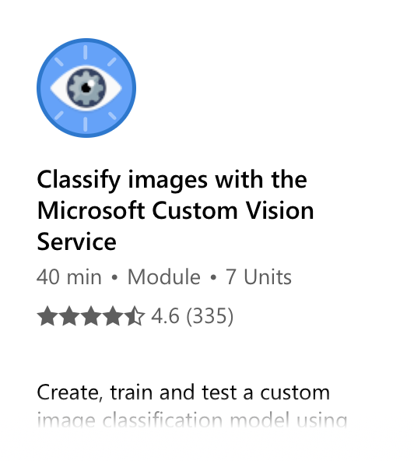
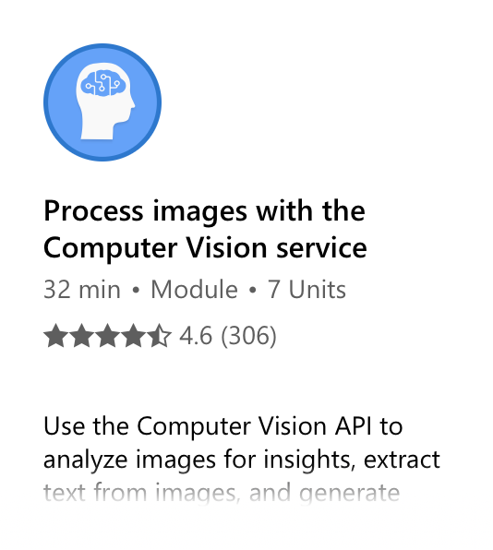
Learn with Microsoft Learn – Vision
aka.ms/HackMIT/

Slide 30
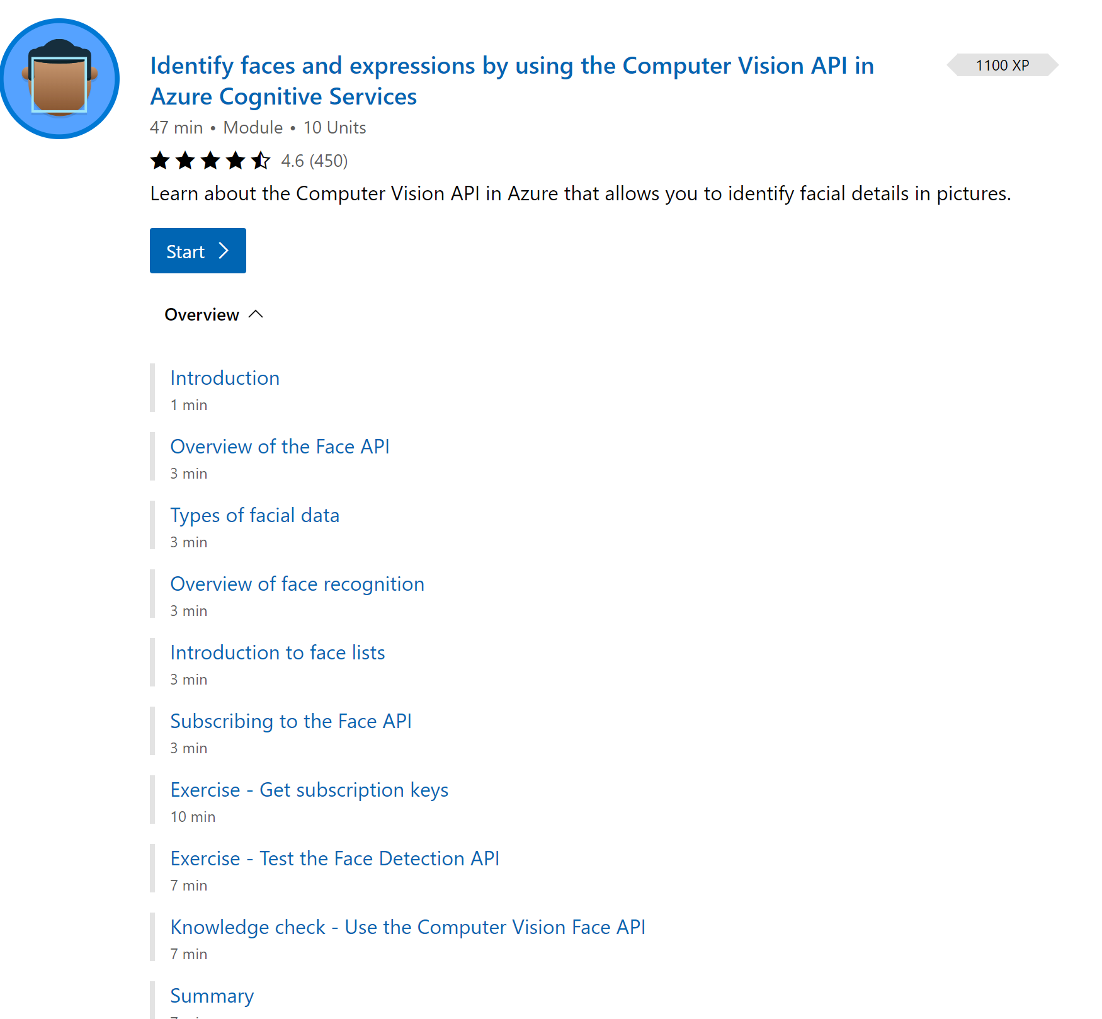
Notes:
When you click into the module you will see an overview and will be able to start the course

Slide 31
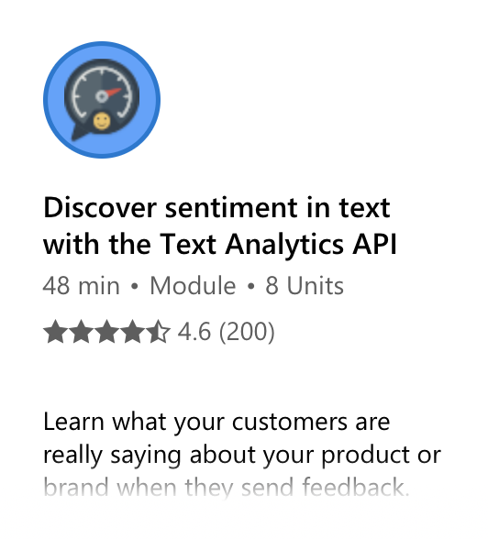
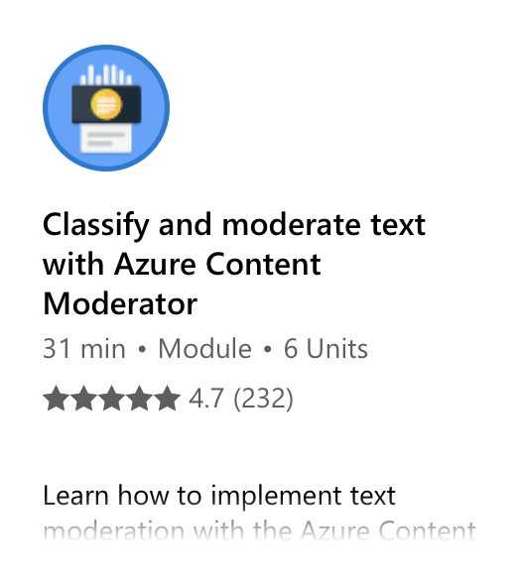
Learn with Microsoft Learn – Text
aka.ms/HackMIT/

Slide 32
Azure AI + ML Services
Create the next generation of applications using AI capabilities for any developer and any scenario!
Cognitive Services
Add smart API capabilities to enable contextual interactions
Azure Machine Learning Service
Build, train and deploy models from the cloud to the edge
Azure Bot Service
Intelligent serverless bot service that scales on demand
Language Understand LUIS
Add conversational, natural language text and pull out relevant, detailed information.
aka.ms/HackMIT/

Slide 33
Azure Machine Learning Service
A service that has all the tools needed to build amazing machine learning solutions.
Notes:
-tools to build custom machine learning models from data to deployment

Slide 34



Azure Machine Learning Service
Authoring tools: Automated ML, Visual Interface, Notebooks and Files
Assets: Datasets, Experiments, ML Workflow Pipelines, Models, Deployments
Management: Compute, Datastores, Workspaces
Notes:
Give an overview of the different tools in AML service workspace
(I pulled these descriptions for docs)
-Automated ML - Automated machine learning, also referred to as autoML, is the process of automating the tasks of machine learning model development.
-Visual Interface-The visual interface for Azure Machine Learning service enables you to prep data, train, test, deploy, manage, and track machine learning models without writing code.
-Notebooks – jupyter notebooks running on cloud vms for building and testing models with code
-Datasets – shared datasets across multiple azure ML tools
-Experiments - Group of Runs from a Script
-Data Pipelines – ML processing workflows
-Models – history and versioning of the trained models
-Deployments – Endpoints of deployed models to consume from an application
-Compute – a way to manage what compute is created and when its used. Helps with managing costs.
-Datastores – azure storage for azure ml workspace
-Workpaces – The azure resource that contains these amazing features.
We are going to be building with Visual designer which uses many of these features behind the scenes when you are building a model. We will show this in the demo

Slide 35
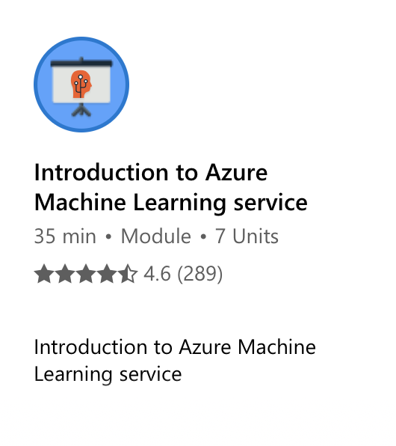
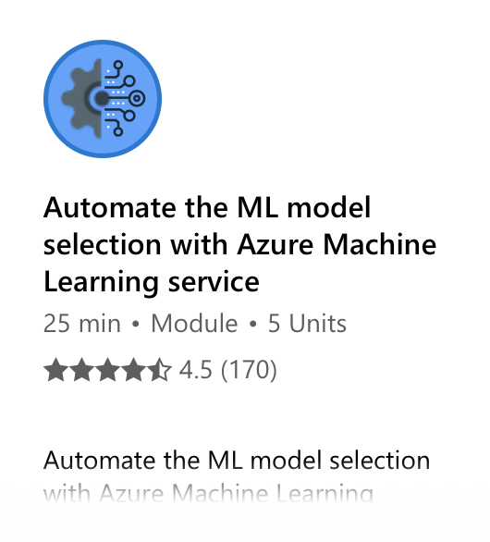
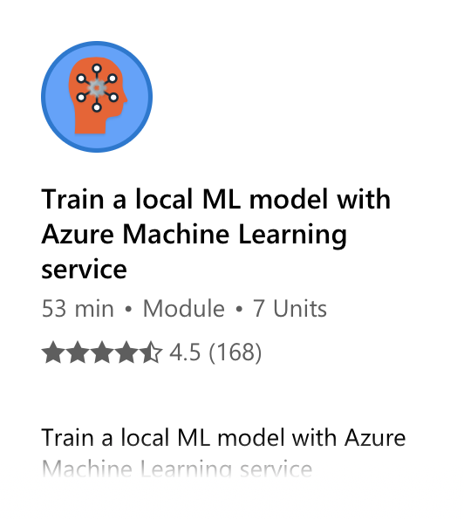
Azure Machine Learning
aka.ms/HackMIT/

Slide 36
Hack with Azure Machine Learning Service
aka.ms/HackMIT/

Slide 37
Azure AI + ML Services
Create the next generation of applications using AI capabilities for any developer and any scenario!
Cognitive Services
Add smart API capabilities to enable contextual interactions
Azure Machine Learning Service
Build, train and deploy models from the cloud to the edge
Azure Bot Service
Intelligent serverless bot service that scales on demand
Language Understand LUIS
Add conversational, natural language text and pull out relevant, detailed information.
aka.ms/HackMIT/

Slide 38
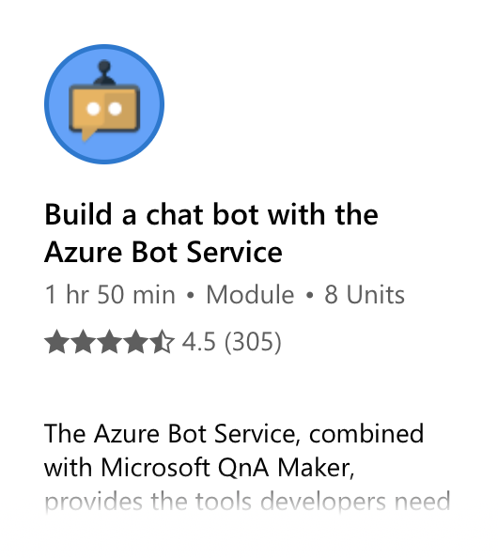
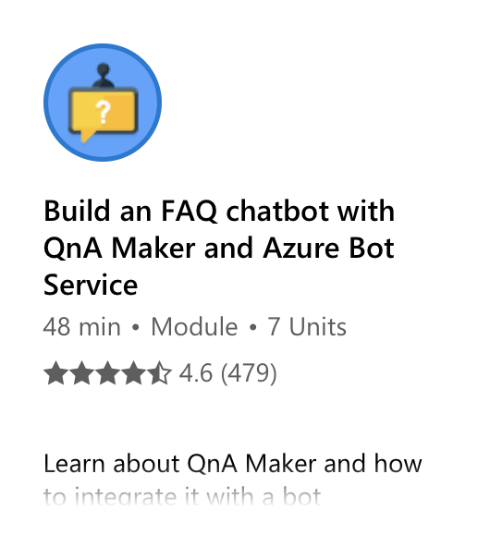
Azure Search and Azure Bot Service
aka.ms/HackMIT/

Slide 39
Hack with Azure Bots
aka.ms/HackMIT/

Slide 40
Azure AI + ML Services
Create the next generation of applications using AI capabilities for any developer and any scenario!
Cognitive Services
Add smart API capabilities to enable contextual interactions
Azure Machine Learning Service
Build, train and deploy models from the cloud to the edge
Azure Bot Service
Intelligent serverless bot service that scales on demand
Language Understand LUIS
Add conversational, natural language text and pull out relevant, detailed information.
aka.ms/HackMIT/

Slide 41
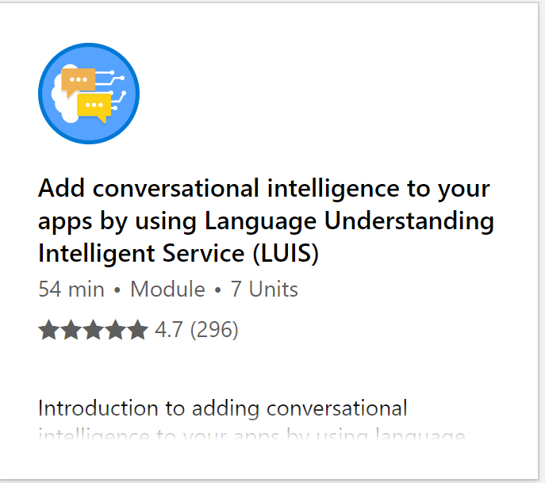
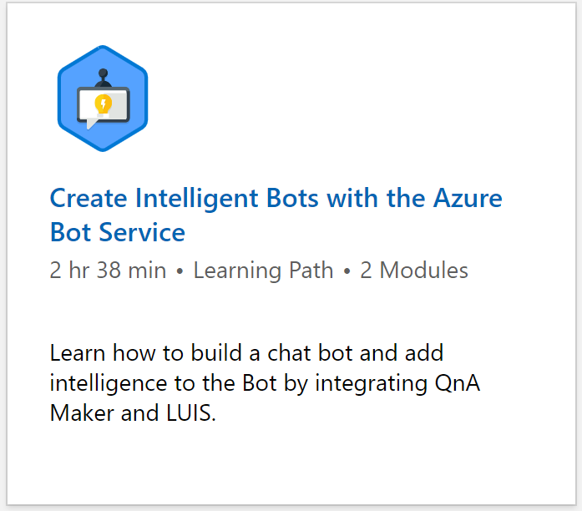
Language Understanding (LUIS)
aka.ms/HackMIT/

Slide 42
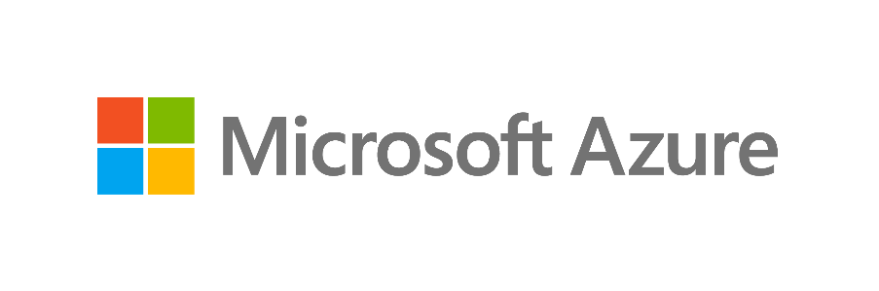
Visit aka.ms/HackWithAzure
aka.ms/HackMIT/
Cassie Breviu
@Cassieview

